Slide 1
Monitoring as a Service
July, 2018

Slide 2
Monitoring as a Service – Reference Episode
Goal:
Moving from a long manual process to configure monitoring for a new app to fully automated monitoring within half an hour. Every Stakeholder gets automated dashboards for their app. Make this a repeatable/standardized process
Assumptions: Working Dynatrace environment. Deployment automation in place, operations tooling available
Sprint 1
Prepare environment for automatically monitoring any newly deployed application
Integrate Dynatrace into environment building
Find proper integration for pipeline tools
Deploy missing tools from testbed
Define new organizational processes and flow
Have environment 0 up and running.
Sprint 2
Integrate new autonomous cloud workflows for first application and test workflows in staging
Ensure daily deploys and updates work flawlessly, and environment adjusts.
Run development fire drills
Run operations fire drills
Run business fire drills
Drive daily standup based
Sprint 3
Prepare application 1 to move over to production. Add enterprise features (security , integrations)
Add integrations for custom data sources
Build management zones
Adjust operational processes
Run app like normal production
Sprint 4
Move first application to production use. Test repeatability for the next application
Dynatrace is now used in all stages
Operations works with new workflows
Processes are validated for other applications as well.
Kick Off with Management
Review with Management
Notes:
Notes with more details on each Sprint
Sprint 1
- Workshop with Testbed to deploy OneAgents on EC2 with Terraform & CloudFormation
- Identify avail deployment tools and environments at customer
- Rollout sample app from testbed using tools available within customer org
- Evaluate Meta Data to be pushed to Dynatrace OneAgents based on customers current processes, e.g. Project Name, Team Ownership, Service Type, Pipeline, …
- Push Customer Specific Meta Data to testbed. Validate correct detection and naming in Dynatrace
- Setup demo integration with available Incident Management Tool (fallback email)
- Outcome: Select first application or part of platform for next sprints. Draw a reference architecture and define HOW this will look like in Dynatrace (hosts, process groups, services, …)
Sprint 2
- Implement rollout of OneAgents; push mandatory meta data and define mandatory rules as defined in Sprint 1 on first application
- Setup a basic HTTP Health Check to validate availability of that service/app
- Setup a basic Synthetic clickpath for end user availability monitoring
- Define a dashboard for Operations (focus in availability, system health)
- Define a dashboard for Development (focus on service performance, throughput, …)
- Define a dashboard for Business (focus on RUM data)
- Setup Notification Integration on Availability issues detected by Synthetic Tests to customers incident management tool → or email if no other tool exists
- Outcome: we have just automatically rolled out Dynatrace and very stakeholder has a starting dashboard. Ops & Biz get notifications
- Outcome 2: List of deployment and configuration events we want to feed to Dynatrace in Sprint 3
Sprint 3
- Define Management Zones for Ops, Dev & Business
- Define first version of Monspec – including the definition of a service and its environments!
- Push additonal Deployment Information as Custom Deployment Events to Dynatrace using Monspec
- Configure a Log Rule that pulls a configuration change log event into a Dynatrace event
- Enable at least one additional "extension option" to pull/push metrics from Non OneAgent data sources, e.g: F5, Kubernetes, StackDriver, …
- Outcome: Dynatrace AI includes new metrics and deployment events in root cause analysis
- Outcome 2: Management Zones allow individidual groups to see what they are supposed to see: Biz, Dev & Ops
Sprint 4
- Rollout Dynatrace for same app/service in other environments, e.g: Dev, Test, Staging, …
- Rollout Dynatrace for a second app / service -> this validates if all metadata and change events are automatically passed to dynatrace. Validates management zones and incident notifications
- Extend monspec for one service and add key metrics in perfsignature. Execute monspec to pull in metrics for a specific envrionment
- Outcome: Dynatrace now deployed in multiple stages and for multiple apps.
- Outcome 2: Management Zones only give access to the correct people
- Outcome 3: Dashboards allow easy access to relevant data
- Outcome 4: Incidents are forwarded to correct people
- Outcome 5:. Monitoring data can also be pulled through API (Monspec) on demand

Slide 3
Outline
Introduction – What is the workshop about?
Labs
Instrument Kubernetes Cluster with Dynatrace OneAgent Operator
Pass and Extract Meta-Data for each deployed Process or Container
Tagging of Services
Push Deployment & Configuration Change Events to Dynatrace
Define Management Zones in Dynatrace to create Access Control
Deploy Sockshop to Staging and validate Automation
Setup Alerting Profile for Availability Issues and Integrate with a ChatOps Tool
Setup Availability Checks
Define Dashboards for Dev (Service), Operations (Availability), Business (RUM)
Configure UEM Rum Tagging
Recap

Slide 4
The Tutorials Sample App Overview when deployed in a single environment

Slide 5
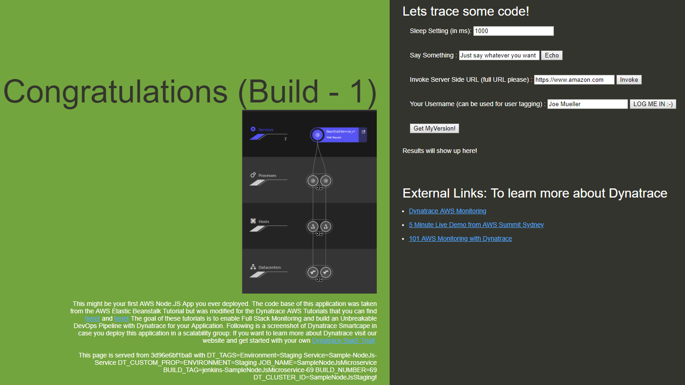
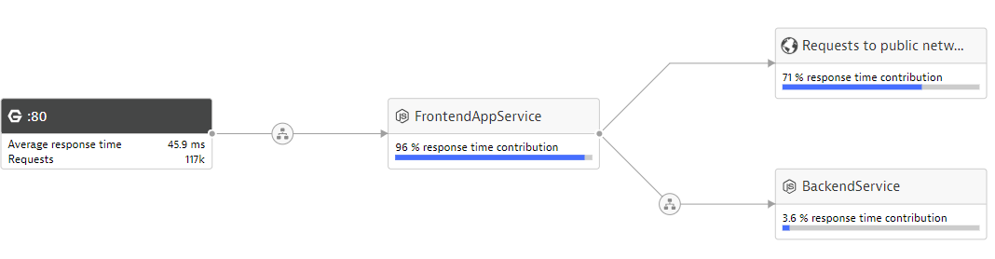
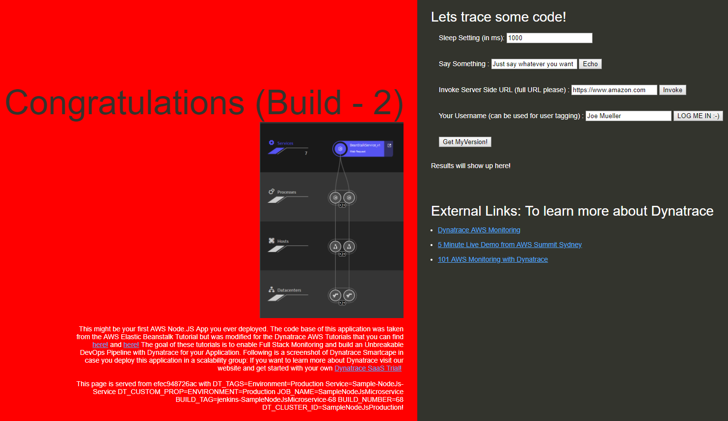
Our Default Stack: NGINX Frontend-Load Balancer, 1-x Frontend Apps, 1 Backend Service
http://yourEC2Machine:80
Downloaded GitHub Repo
./run_frontend2builds_clustered.sh
1x
4x
(2 – Build #1)
(2 – Build #2)
1x
Docker
Dynatrace CLI (dockerized)
Installed OneAgent
EC2 Instance running Docker (Created through CF Stack DynatraceMonitoringAsAServiceCFStack.json)

Slide 6
Understanding OneAgent & Smartscape Out-of-the-Box & Additional Meta Data Options

Slide 7
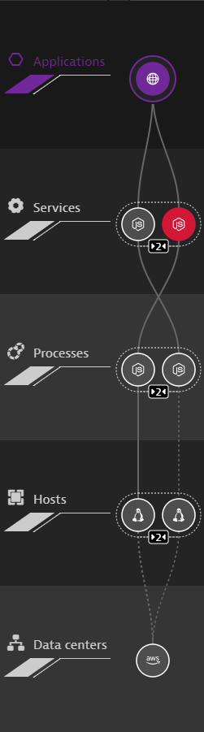
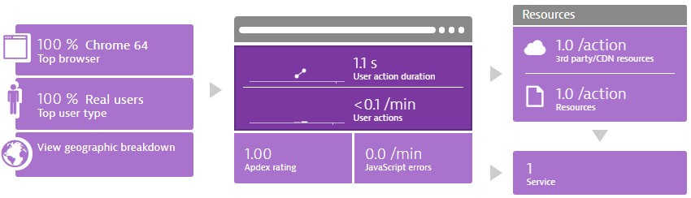
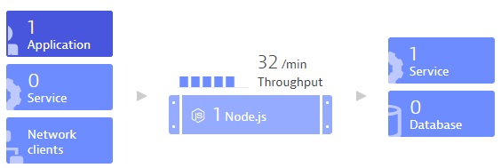
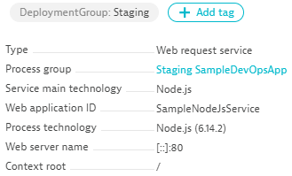





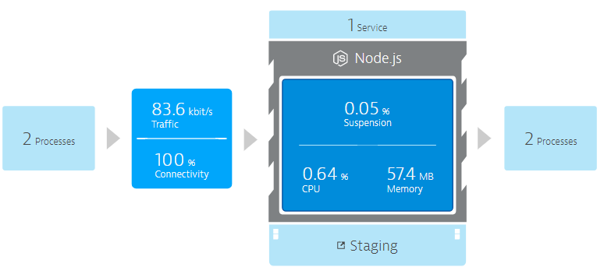
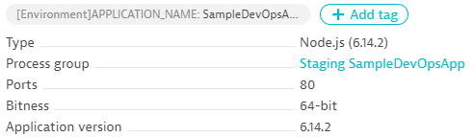
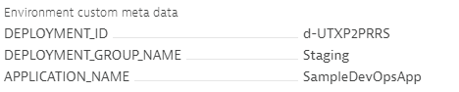


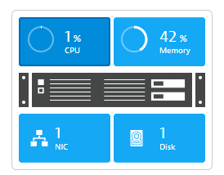


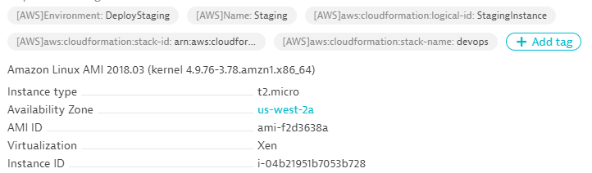

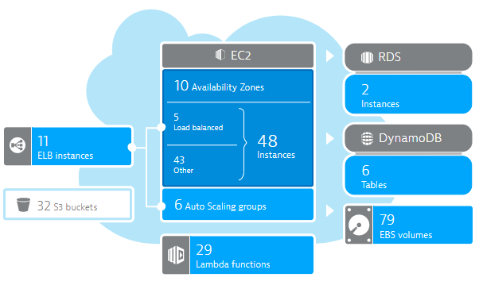

DT_TAGS=APP_NAME=Sample
DT_CUSTOM_PROPS=Staging
DT_NODE_ID=Build1
launchApp.sh
User Data:
wget OneAgent.sh
./OneAgent.sh
hostautotag.conf, hostcustomproperty.conf
AWS EC2 (Tag=Staging)
CloudWatch

Slide 8
Process Groups (PGs) & Process Groups Instances (PGIs) Understanding these Key Concepts is crucial

Slide 9
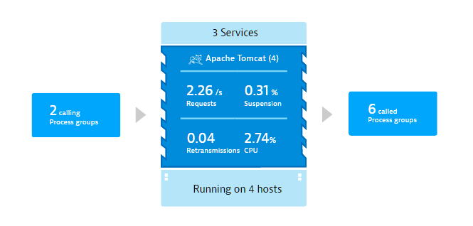
#1 – What are ProcessGroups?
Cluster of processes that belong together
Run the same software
Between ”Host” and “Service”
Application
Service
ProcessGroup
Host
Notes:
So now that we got that out of the way, we can discuss ProcessGroups. Unsurprisingly, ProcessGroups are non-other than groups of processes! Tomcat cluster, Jboss cluster, WebSphere cluster. In the SmartScape view this logically lies between the Host and services.

Slide 10
#1 – What are ProcessGroups?
Used as a point of configuration
Process, Plugin metrics continuity
Like agent groups, but automatic and for all types of processes
Service
JourneyService
AuthService
BookingService
ProcessGroup
Business backend
Host
EC2 instance
Notes:
The differences is that Dynatrace will automatically create these ‘configuration buckets’ based on its understanding of the individual processes. This allows the process to restart, updata, etc, without losing metric continuity or configurations stored within Dynatrace. If you familiar with AppMon you safely think of ProcessGroups as agent groups.

Slide 11
#1 – What are ProcessGroups?
Should be stable – no new PG created with new deployment/version
Process Groups are logical boundaries for Services
Recreate the ProcessGroup with new detection rule == new Service!!!
JourneyService
AuthService
JourneyService
AuthService
BookingService
BookingService
BusinessBackend
BusinessBackend (PGI 1)
BusinessBackend
(PGI 2)
BB-Host
BB-Host-1
BB-Host-2
Notes:
It is immensely important for these ProcessGroups to not be re-created upon a new release, so Dynatrace based this off of Stable “static” data. It is also import to understand that ProcessGroups are “logical boundaries” That means is the 3 services are on the Business backend service cannot exist on any other process group. It is a 1 to many relationship between ProcessGroups and Services. Since they can’t exist on separate PGs, that means if a new one is created each deployment – the services will be recreated, including their configurations

Slide 12
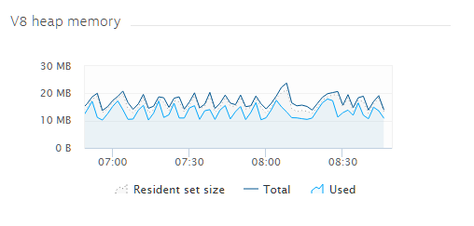
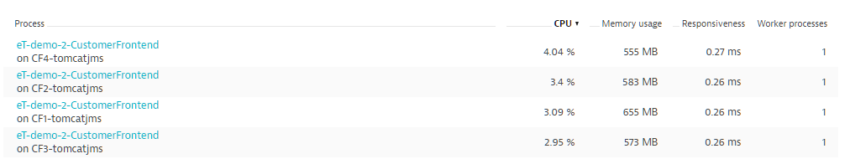
#1 – What are ProcessGroups?
Process vs Process group instance:
A ProcessGroup on a host is a process group instance
Normally one process with chart continuity (restart, crash redeploy)

Slide 13
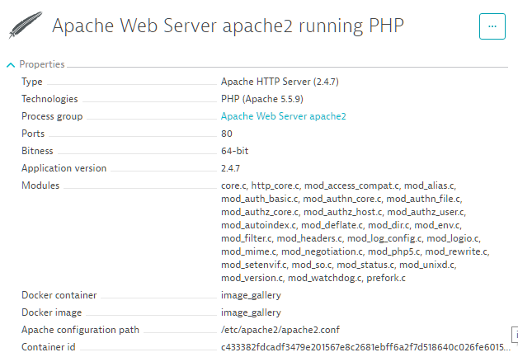
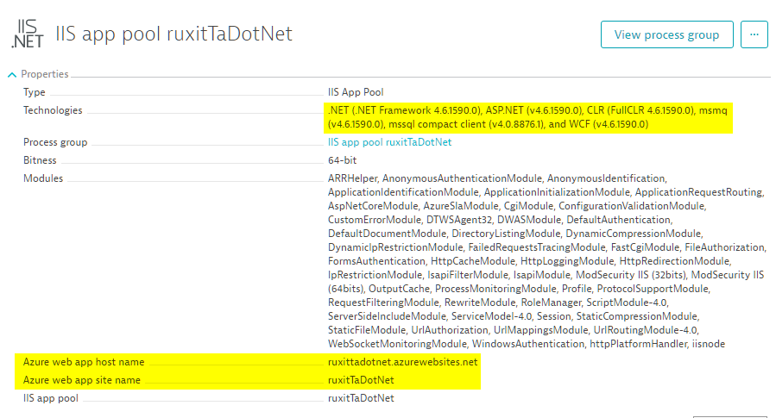
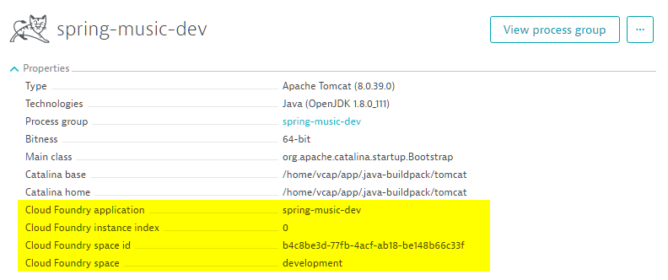
#2 – Detection
Lots of built-in rules: Java, Jboss, WebSphere, Node, Apache, Databases….
Many special rules: Docker, Azure, CloudFoundry, OpenShift, ColdFusion….
Intention: Stable, meaningful and meta data
Notes:
So now lets talk about OOTB detection rules for

Slide 14
#3 – Customization
 | Manual renaming | “Quick-Rules” | Define rule-based detection policies | DT_CLUSTER_ID environment variable
Description | Technologies > ProcessGroup > Edit | Built in detection options for specific technologies | Leverage and customize detected metadata or create your own metadata and apply it as PG name | All “unique” processes (i.e. Java) will be defined as this variable. Prioritized over all other rule definitions
Pros | Quick and easy | Quick and easy, OOTB configuration options | Options, best for cleaning up tricky PGs | Easily automated, no worries about change to PG metadata
Cons | Will NOT carry over to new ProcessGroup if ‘detected name’ contains a unique value that changes with each deployment | Applies to ALL processes of that technology. Only for Tomcat, Docker, and Cassandra | Possibly difficult to triage if PG no longer fulfills the conditions of the rules | All “unique” processes (i.e. Java) will be defined as this variable
Notes:
What happens when we don’t have quality result? We can customize it!
Not perfect for unknown technologies and frameworks – i.e. version numbers being captured
Everything looks the same – i.e. “tomcat” as the name for all tomcat ProcessGroups
Fine tuning of names

Slide 15
#4 – Applied to our Sample App
Default Detection: All container images in a single PGI
Service
FrontendAppService
BackendService
nginx
PG
frontend-app
backend-service
Frontend-loadbalancer
PGI
frontend-app
backend-service
Frontend-loadbalancer
Host
DTMaaSLab2Host
Detecting Each Individual Build as PGI – differentiate through, e.g: DT_NODE_ID or Process Group Detection Rule!
Service
FrontendAppService
BackendService
nginx
PG
frontend-app
backend-service
Frontend-loadbalancer
PGI
frontend-app (B1)
frontend-app (B2)
backend-service
Frontend-loadbalancer
Host
DTMaaSLab2Host
Notes:
It is immensely important for these ProcessGroups to not be re-created upon a new release, so Dynatrace based this off of Stable “static” data. It is also import to understand that ProcessGroups are “logical boundaries” That means is the 3 services are on the Business backend service cannot exist on any other process group. It is a 1 to many relationship between ProcessGroups and Services. Since they can’t exist on separate PGs, that means if a new one is created each deployment – the services will be recreated, including their configurations

Slide 16
Appendix – Best practices for ProcessGroups
Unique enough to easily identify the role the process has
No version numbers
”Environments” split out
Don’t manually change the name unless 100% certain it will be consistent through deployments
Configure ProcessGroups BEFORE Services if at all possible
ALL rule changes require a process restart to take effect

Slide 17
Monitoring as a Service Automation aspects of FullStack Monitoring

Slide 18
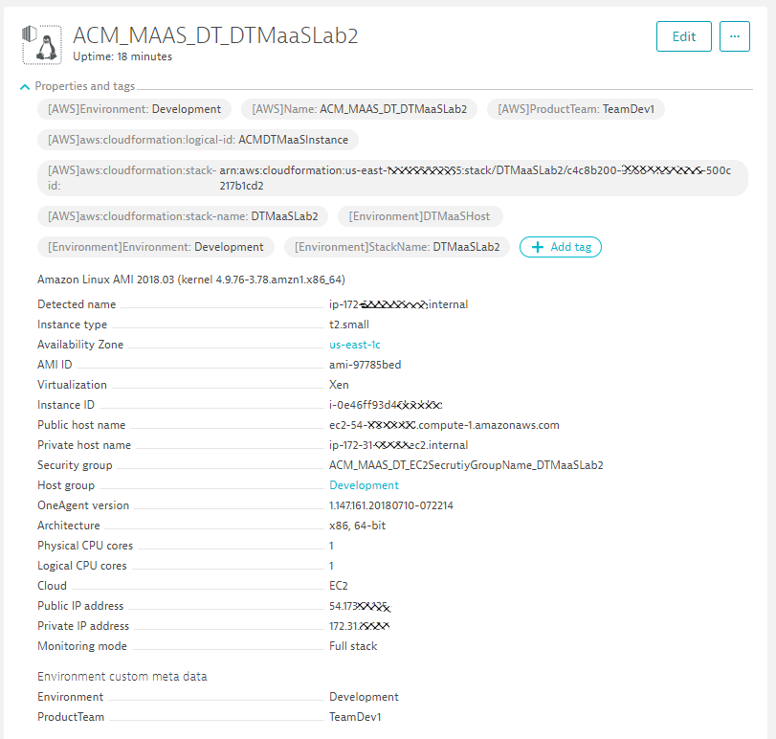
Passing Host Information
[AWS]:* Tags through AWS CloudWatch Integration
[Environment]:* through hostautotag.conf
Host Group through Installation Parameter
Environment Custom Meta Data through hostcustomproperties.conf

Slide 19
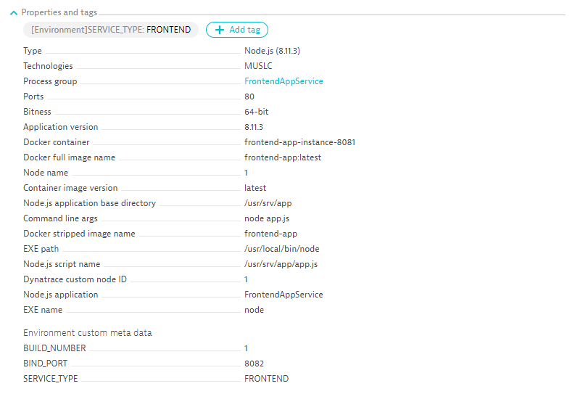
Passing Process Group Information
DT_TAGS
DT_NODE_ID
DT_CUSTOM_PROPS

Slide 20
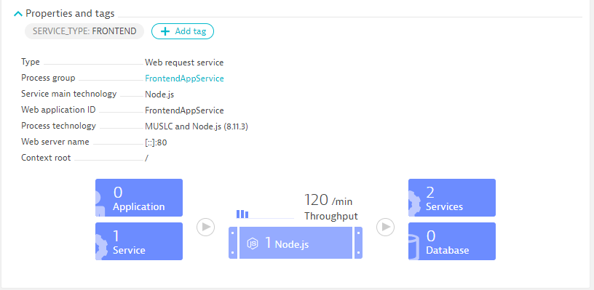
Propagating Service Information
Automated Tagging Rule

